Slide 1
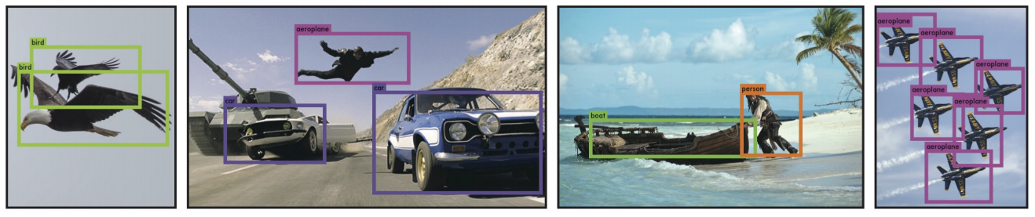
YOLO
You Only Look Once: Unified, Real-Time Object Detection
Joseph Redmon, Santosh Divvala, Ross Girshick, Ali Farhadi

Slide 2
Big picture
mAP
Faster R-CNN
SSD
Fast R-CNN
FPS: 7
mAP: 73.2
FPS: 58
mAP: 72.1
FPS: 0.5
mAP: 70
YOLO
FPS: 45
mAP: 63.4
R-CNN
FPS: -
mAP: 58.5
DPM
FPS: 0.5
mAP: 34.3
Time
Nov 2013
Apr 2015
June 2015
Dec 2015
Результаты на тестовой выборки Pascal VOC 2007. Обучение на trainval sets 2007+2012

Slide 3
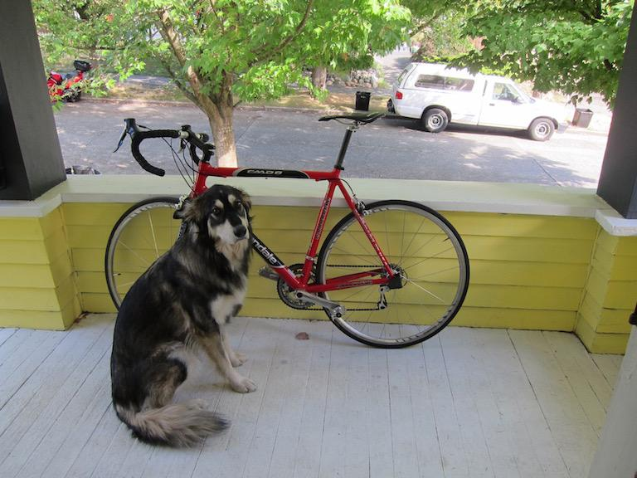
Inference
Input
image
448x448x3

Slide 4
Inference
Input
image
GoogLeNet modification
(20 layers)
14x14x1024
448x448x3

Slide 5
Inference
Input
image
GoogLeNet modification
(20 layers)
C,R
14x14x1024
14x14x1024
448x448x3

Slide 6
Inference
Input
image
GoogLeNet modification
(20 layers)
C,R
C,R
14x14x1024
14x14x1024
14x14x1024
448x448x3

Slide 7
Inference
Input
image
GoogLeNet modification
(20 layers)
C,R
C,R
C,R
14x14x1024
14x14x1024
14x14x1024
7x7x1024
448x448x3

Slide 8
Inference
Input
image
GoogLeNet modification
(20 layers)
C,R
C,R
C,R
C,R
14x14x1024
14x14x1024
14x14x1024
7x7x1024
7x7x1024
448x448x3

Slide 9
Inference
Input
image
GoogLeNet modification
(20 layers)
C,R
C,R
C,R
C,R
FC,R
14x14x1024
14x14x1024
14x14x1024
7x7x1024
7x7x1024
4096x1
448x448x3

Slide 10
Inference
Input
image
GoogLeNet modification
(20 layers)
C,R
C,R
C,R
C,R
FC,R
FC
14x14x1024
14x14x1024
14x14x1024
7x7x1024
7x7x1024
4096x1
1470x1
448x448x3

Slide 11
Inference
Input
image
GoogLeNet modification
(20 layers)
C,R
C,R
C,R
C,R
FC,R
FC
Reshape
7x7x1024
7x7x1024
7x7x30
14x14x1024
14x14x1024
14x14x1024
4096x1
1470x1
448x448x3

Slide 12
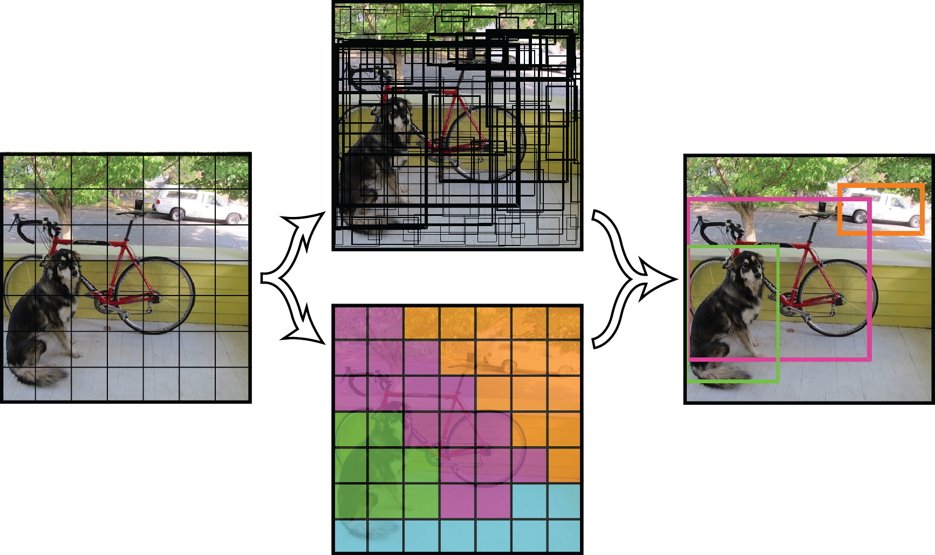
Inference
Input
image
GoogLeNet modification
(20 layers)
C,R
C,R
C,R
C,R
FC,R
FC
Reshape
7x7x1024
7x7x1024
7x7x30
14x14x1024
14x14x1024
14x14x1024
4096x1
1470x1
448x448x3
Detection Procedure

Slide 13
Inference
Input
image
GoogLeNet modification
(20 layers)
C,R
C,R
C,R
C,R
FC,R
FC
Reshape
7x7x1024
7x7x1024
7x7x30
14x14x1024
14x14x1024
14x14x1024
Train from scratch
4096x1
1470x1
448x448x3
Detection Procedure

Slide 14
Inference
use new additional conv layers => better performance
Input
image
GoogLeNet modification
(20 layers)
C,R
C,R
C,R
C,R
FC,R
FC
Reshape
7x7x1024
7x7x1024
7x7x30
14x14x1024
14x14x1024
14x14x1024
4096x1
1470x1
448x448x3
Detection Procedure

Slide 15
Inference
Input
image
Detection
Procedure
GoogLeNet modification
(20 layers)
C,R
C,R
C,R
C,R
FC,R
FC
Reshape
7x7x30
14x14x1024
14x14x1024
14x14x1024
7x7x1024
7x7x1024
4096x1
1470x1
448x448x3
Tensor values interpretation
7
7
30

Slide 16
Inference
Input
image
Detection
Procedure
GoogLeNet modification
(20 layers)
C,R
C,R
C,R
C,R
FC,R
FC
Reshape
7x7x30
14x14x1024
14x14x1024
14x14x1024
7x7x1024
7x7x1024
4096x1
1470x1
448x448x3
Tensor values interpretation
7
7
30

Slide 17
Inference
Input
image
Detection
Procedure
GoogLeNet modification
(20 layers)
C,R
C,R
C,R
C,R
FC,R
FC
Reshape
7x7x30
14x14x1024
14x14x1024
14x14x1024
7x7x1024
7x7x1024
4096x1
1470x1
448x448x3
Tensor values interpretation
7
7
30
7
grid cell
7

Slide 18
Inference
Input
image
Detection
Procedure
GoogLeNet modification
(20 layers)
C,R
C,R
C,R
C,R
FC,R
FC
Reshape
7x7x30
14x14x1024
14x14x1024
14x14x1024
7x7x1024
7x7x1024
4096x1
1470x1
448x448x3
Tensor values interpretation
7
7
30
7
grid cell
7

Slide 19
Inference
Input
image
Detection
Procedure
GoogLeNet modification
(20 layers)
C,R
C,R
C,R
C,R
FC,R
FC
Reshape
7x7x30
14x14x1024
14x14x1024
14x14x1024
7x7x1024
7x7x1024
4096x1
1470x1
448x448x3
Tensor values interpretation
1x30
7
7
30
7
grid cell
7

Slide 20
Inference
Input
image
Detection
Procedure
GoogLeNet modification
(20 layers)
C,R
C,R
C,R
C,R
FC,R
FC
Reshape
7x7x30
14x14x1024
14x14x1024
14x14x1024
7x7x1024
7x7x1024
4096x1
1470x1
448x448x3
Tensor values interpretation
1x30
5
7
x - coordinate of bbox center inside cell ([0; 1] wrt grid cell size)
y - coordinate of bbox center inside cell ([0; 1] wrt grid cell size)
w - bbox width ([0; 1] wrt image)
h - bbox height ([0; 1] wrt image)
c - bbox confidence ~ P(obj in bbox1)
7
30
7
grid cell
7

Slide 21
Inference
Input
image
Detection
Procedure
GoogLeNet modification
(20 layers)
C,R
C,R
C,R
C,R
FC,R
FC
Reshape
7x7x30
14x14x1024
14x14x1024
14x14x1024
7x7x1024
7x7x1024
4096x1
1470x1
448x448x3
Tensor values interpretation
1x30
5
5
7
x - coordinate of bbox center inside cell ([0; 1] wrt grid cell size)
y - coordinate of bbox center inside cell ([0; 1] wrt grid cell size)
w - bbox width ([0; 1] wrt image)
h - bbox height ([0; 1] wrt image)
c - bbox confidence ~ P(obj in bbox2)
7
30
7
grid cell
7

Slide 22
Inference
Input
image
Detection
Procedure
GoogLeNet modification
(20 layers)
C,R
C,R
C,R
C,R
FC,R
FC
Reshape
7x7x30
14x14x1024
14x14x1024
14x14x1024
7x7x1024
7x7x1024
4096x1
1470x1
448x448x3
Tensor values interpretation
1x30
5
5
7
7
30
two bboxes for each grid cell
7
grid cell
7

Slide 23
Inference
Input
image
Detection
Procedure
GoogLeNet modification
(20 layers)
C,R
C,R
C,R
C,R
FC,R
FC
Reshape
7x7x30
14x14x1024
14x14x1024
14x14x1024
7x7x1024
7x7x1024
4096x1
1470x1
448x448x3
Tensor values interpretation
1x30
5
5
20 - number of classes
7
7
30
7
grid cell
7

Slide 24
Inference
Input
image
Detection
Procedure
GoogLeNet modification
(20 layers)
C,R
C,R
C,R
C,R
FC,R
FC
Reshape
7x7x30
14x14x1024
14x14x1024
14x14x1024
7x7x1024
7x7x1024
4096x1
1470x1
448x448x3
Tensor values interpretation
i (from 1 to 20)
1x30
5
5
20 - number of classes
Class score ~ P(obj is class_i | obj in box)
7
7
30
7
grid cell
7

Slide 25
Inference
Input
image
Detection
Procedure
GoogLeNet modification
(20 layers)
C,R
C,R
C,R
C,R
FC,R
FC
Reshape
7x7x30
14x14x1024
14x14x1024
14x14x1024
7x7x1024
7x7x1024
4096x1
1470x1
448x448x3
Tensor values interpretation
bb1 confidence
1x30
5
5
20
MUL
7
7
30
7
grid cell
Class scores for bb1
7
20x1

Slide 26
Inference
Input
image
Detection
Procedure
GoogLeNet modification
(20 layers)
C,R
C,R
C,R
C,R
FC,R
FC
Reshape
7x7x30
14x14x1024
14x14x1024
14x14x1024
7x7x1024
7x7x1024
4096x1
1470x1
448x448x3
Tensor values interpretation
bb2 confidence
1x30
5
5
20
MUL
7
7
30
7
grid cell
Class scores for bb2
7
20x1

Slide 27
Inference
Input
image
Detection
Procedure
GoogLeNet modification
(20 layers)
C,R
C,R
C,R
C,R
FC,R
FC
Reshape
7x7x30
14x14x1024
14x14x1024
14x14x1024
7x7x1024
7x7x1024
4096x1
1470x1
448x448x3
Tensor values interpretation
bb2 confidence
1x30
5
5
20
MUL
7
7
30
7
Do this operation for each bbox in each grid cell
grid cell
Class scores for bb2
7
20x1

Slide 28
Inference
Input
image
Detection
Procedure
GoogLeNet modification
(20 layers)
C,R
C,R
C,R
C,R
FC,R
FC
Reshape
7x7x30
14x14x1024
14x14x1024
14x14x1024
7x7x1024
7x7x1024
4096x1
1470x1
448x448x3
Tensor values interpretation
2 bboxes for first cell (1, 1)
bb1
bb2
7
7
30
grid cell (1, 1)
7
7
20x1
20x1

Slide 29
Inference
Input
image
Detection
Procedure
GoogLeNet modification
(20 layers)
C,R
C,R
C,R
C,R
FC,R
FC
Reshape
7x7x30
14x14x1024
14x14x1024
14x14x1024
7x7x1024
7x7x1024
4096x1
1470x1
448x448x3
Tensor values interpretation
2 bboxes for second cell (1, 2)
bb1
bb2
bb4
bb3
7
7
30
grid cell (1, 2)
7
7
20x1
20x1
20x1
20x1

Slide 30
Inference
Input
image
Detection
Procedure
GoogLeNet modification
(20 layers)
C,R
C,R
C,R
C,R
FC,R
FC
Reshape
7x7x30
14x14x1024
14x14x1024
14x14x1024
7x7x1024
7x7x1024
4096x1
1470x1
448x448x3
Tensor values interpretation
2 bboxes for last cell (7, 7)
bb1
bb2
bb4
bb97
bb98
bb3
7
7
30
7
…….
grid cell (7, 7)
7
20x1
20x1
20x1
20x1
20x1
20x1
20x1
20x1
20x1
20x1
20x1
20x1
20x1
20x1
20x1

Slide 31
Inference
Input
image
Detection
Procedure
GoogLeNet modification
(20 layers)
C,R
C,R
C,R
C,R
FC,R
FC
Reshape
7x7x30
14x14x1024
14x14x1024
14x14x1024
7x7x1024
7x7x1024
4096x1
1470x1
448x448x3
Tensor values interpretation
Total 7*7*2 = 98 bboxes
bb1
bb2
bb4
bb97
bb98
bb3
7
7
30
7
…….
grid cell (7, 7)
7

Slide 32
Look at detection procedure
Detection
Procedure
7x7x30

Slide 33
bb1
bb2
bb3
bb98
bb4
bb97
…….
20x1
20x1
Class scores for each bbox

Slide 34
bb1
bb2
bb3
bb98
bb4
bb97
Dog scores
…….
20x1
20x1
Class scores for each bbox
Get first class scores for each bbox

Slide 35
bb1
bb2
bb3
bb98
bb4
bb97
bb1
bb2
bb3
bb98
bb4
bb97
Dog scores
0
0
0
Set zero
if score < thresh1 (0.2)
…….
…….
20x1
20x1

Slide 36
bb98
bb1
bb2
bb98
bb1
bb2
bb3
bb3
bb98
bb4
bb97
bb1
bb2
bb3
bb98
bb4
bb4
bb97
Dog scores
0
0
0
0
0
0
Set zero
if score < thresh1 (0.2)
Sort descending
…….
…….
…….
20x1
20x1

Slide 37
bb98
bb1
bb2
bb98
bb1
bb2
bb3
bb3
bb98
bb4
bb97
bb1
bb2
bb3
bb98
bb4
bb4
bb97
bb1
bb2
bb98
bb3
bb98
bb4
Dog scores
0
0
0
0
0
0
0
0
0
0
Set zero
if score < thresh1 (0.2)
NMS algorithm set
scores to zero for redundant bboxes
Sort descending
…….
…….
…….
…….
20x1
20x1

Slide 38
bb98
bb1
bb2
bb98
bb1
bb2
bb3
bb3
bb98
bb4
bb97
bb1
bb2
bb3
bb98
bb4
bb4
bb97
bb1
bb2
bb98
bb3
bb98
bb4
Dog scores
0
0
0
0
0
0
0
0
0
0
Set zero
if score < thresh1 (0.2)
NMS algorithm set
scores to zero for redundant bboxes
Sort descending
…….
…….
…….
…….
20x1
20x1
How it works

Slide 39
Non-Maximum Suppression: intuition

Slide 40
Non-Maximum Suppression: intuition
class (dog) scores for each bbox
bb47
bb20
bb15
bb7
bb1
bb4
bb8
bb98
class: dog
0.5
0.3
0.2
0.1
0
0
0
0
1x98

Slide 41
Non-Maximum Suppression: intuition
class (dog) scores for each bbox
bb47
bb20
bb15
bb7
bb1
bb4
bb8
bb98
class: dog
0.5
0.3
0.2
0.1
0
0
0
0
1x98

Slide 42
Non-Maximum Suppression: intuition
class (dog) scores for each bbox
bb47
bb20
bb15
bb7
bb1
bb4
bb8
bb98
class: dog
0.5
0.3
0.2
0.1
0
0
0
0
1x98

Slide 43
Non-Maximum Suppression: intuition
class (dog) scores for each bbox
bb47
bb20
bb15
bb7
bb1
bb4
bb8
bb98
class: dog
0.5
0.3
0.2
0.1
0
0
0
0
1x98

Slide 44
Non-Maximum Suppression: intuition
class (dog) scores for each bbox
bb47
bb20
bb15
bb7
bb1
bb4
bb8
bb98
class: dog
0.5
0.3
0.2
0.1
0
0
0
0
1x98

Slide 45
Non-Maximum Suppression: intuition
class (dog) scores for each bbox
bb47
bb20
bb15
bb7
bb1
bb4
bb8
bb98
class: dog
0.5
0.3
0.2
0.1
0
0
0
0
1x98

Slide 46
Non-Maximum Suppression: intuition
class (dog) scores for each bbox
bb47
bb20
bb15
bb7
bb1
bb4
bb8
bb98
class: dog
0.5
0.3
0.2
0.1
0
0
0
0
1x98
Get bbox with max score. Let’s denote it “bbox_max”

Slide 47
Non-Maximum Suppression: intuition
class (dog) scores for each bbox
bb47
bb20
bb15
bb7
bb1
bb4
bb8
bb98
class: dog
0.5
0.3
0.2
0.1
0
0
0
0
1x98
Compare “bbox_max” with others less score (non-zero!) bboxes. Let’s denote it “bbox_cur”

Slide 48
Non-Maximum Suppression: intuition
class (dog) scores for each bbox
bb47
bb20
bb15
bb7
bb1
bb4
bb8
bb98
class: dog
0.5
0.3
0.2
0.1
0
0
0
0
1x98
If IoU(bbox_max, bbox_cur) > 0.5 then set 0 score to bbox_cur.

Slide 49
Non-Maximum Suppression: intuition
class (dog) scores for each bbox
bb47
bb20
bb15
bb7
bb1
bb4
bb8
bb98
class: dog
0.5
0
0.2
0.1
0
0
0
0
1x98
If IoU(bbox_max, bbox_cur) > 0.5 then set 0 score to bbox_cur.
In this case: set to 0.

Slide 50
Non-Maximum Suppression: intuition
class (dog) scores for each bbox
bb47
bb20
bb15
bb7
bb1
bb4
bb8
bb98
class: dog
0.5
0
0.2
0.1
0
0
0
0
1x98
Go to next bbox_cur.

Slide 51
Non-Maximum Suppression: intuition
class (dog) scores for each bbox
bb47
bb20
bb15
bb7
bb1
bb4
bb8
bb98
class: dog
0.5
0
0.2
0.1
0
0
0
0
1x98
Go to next bbox_cur.
If IoU(bbox_max, bbox_cur) > 0.5 then set 0 score to bbox_cur.

Slide 52
Non-Maximum Suppression: intuition
class (dog) scores for each bbox
bb47
bb20
bb15
bb7
bb1
bb4
bb8
bb98
class: dog
0.5
0
0.2
0.1
0
0
0
0
1x98
Go to next bbox_cur.
If IoU(bbox_max, bbox_cur) > 0.5 then set 0 score to bbox_cur.
In this case: continue.

Slide 53
Non-Maximum Suppression: intuition
class (dog) scores for each bbox
bb47
bb20
bb15
bb7
bb1
bb4
bb8
bb98
class: dog
0.5
0
0.2
0.1
0
0
0
0
1x98
Go to next bbox_cur.

Slide 54
Non-Maximum Suppression: intuition
class (dog) scores for each bbox
bb47
bb20
bb15
bb7
bb1
bb4
bb8
bb98
class: dog
0.5
0
0.2
0.1
0
0
0
0
1x98
Go to next bbox_cur.
If IoU(bbox_max, bbox_cur) > 0.5 then set 0 score to bbox_cur.

Slide 55
Non-Maximum Suppression: intuition
class (dog) scores for each bbox
bb47
bb20
bb15
bb7
bb1
bb4
bb8
bb98
class: dog
0.5
0
0.2
0.1
0
0
0
0
1x98
Go to next bbox_cur.
If IoU(bbox_max, bbox_cur) > 0.5 then set 0 score to bbox_cur.
In this case: continue.

Slide 56
Non-Maximum Suppression: intuition
class (dog) scores for each bbox
bb47
bb20
bb15
bb7
bb1
bb4
bb8
bb98
class: dog
0.5
0
0.2
0.1
0
0
0
0
1x98
Go to next bbox_cur.
If IoU(bbox_max, bbox_cur) > 0.5 then set 0 score to bbox_cur.
In this case: continue.
Do this procedure for other “bbox_cur”. After that ...

Slide 57
Non-Maximum Suppression: intuition
class (dog) scores for each bbox
bb47
bb20
bb15
bb7
bb1
bb4
bb8
bb98
class: dog
0.5
0.2
0
1x98
0
0.1
0
0
0
Go to next bbox with big score. Let’s denote it “bbox_max”

Slide 58
Non-Maximum Suppression: intuition
class (dog) scores for each bbox
bb47
bb20
bb15
bb7
bb1
bb4
bb8
bb98
class: dog
0.5
0.2
0
1x98
0
0.1
0
0
0
Go to next bbox_cur.

Slide 59
Non-Maximum Suppression: intuition
class (dog) scores for each bbox
bb47
bb20
bb15
bb7
bb1
bb4
bb8
bb98
class: dog
0.5
0.2
0
1x98
0
0.1
0
0
0
Go to next bbox_cur.
If IoU(bbox_max, bbox_cur) > 0.5 then set 0 score to bbox_cur.

Slide 60
Non-Maximum Suppression: intuition
class (dog) scores for each bbox
bb47
bb20
bb15
bb7
bb1
bb4
bb8
bb98
class: dog
0.5
0.2
0
0
1x98
0
0
0
0
Go to next bbox_cur.
If IoU(bbox_max, bbox_cur) > 0.5 then set 0 score to bbox_cur.
In this case: set to 0.
Do this procedure for other “bbox_max” and for other corresponding “bbox_cur”.

Slide 61
Non-Maximum Suppression: intuition
class (dog) scores for each bbox
bb47
bb20
bb15
bb7
bb1
bb4
bb8
bb98
class: dog
0.5
0.2
0
0
1x98
0
0
0
0
After comparison almost all pairs of bboxes the only two bboxes left with non-zero class score value.

Slide 62
bb98
bb1
bb2
bb98
bb1
bb2
bb3
bb3
bb98
bb4
bb97
bb1
bb2
bb3
bb98
bb4
bb4
bb97
bb1
bb2
bb98
bb3
bb98
bb4
Cat scores
0
0
0
0
0
0
0
0
0
0
Set zero
if score < thresh1 (0.2)
NMS algorithm set
scores to zero for redundant bboxes
Sort descending
…….
…….
…….
…….
20x1
20x1
Do this procedure for next class

Slide 63
bb98
bb1
bb2
bb98
bb1
bb2
bb3
bb3
bb98
bb4
bb97
bb1
bb2
bb3
bb98
bb4
bb4
bb97
bb1
bb2
bb98
bb3
bb98
bb4
Set zero
if score < thresh1 (0.2)
NMS algorithm set
scores to zero for redundant bboxes
Sort descending
…….
…….
…….
…….
person scores
0
0
0
0
0
0
0
0
0
0
20x1
20x1
Do this procedure for all classes

Slide 64
bb98
bb1
bb2
bb98
bb1
bb2
bb3
bb3
bb98
bb4
bb97
bb1
bb2
bb3
bb98
bb4
bb4
bb97
bb1
bb2
bb98
bb3
bb98
bb4
0
0
0
Set zero
if score < thresh1 (0.2)
NMS algorithm set
scores to zero for redundant bboxes
Sort descending
0
…….
…….
…….
…….
0
0
person scores
0
0
0
0
0
0
0
0
0
0
20x1
20x1
After this procedure -
a lot of zeros

Slide 65
bb98
bb1
bb2
bb98
bb1
bb2
bb3
bb3
bb98
bb4
bb97
bb1
bb2
bb3
bb98
bb4
bb4
bb97
bb1
bb2
bb98
bb3
bb98
bb4
0
0
0
Set zero
if score < thresh1 (0.2)
NMS algorithm set
scores to zero for redundant bboxes
Sort descending
0
…….
…….
…….
…….
0
0
person scores
0
0
0
0
0
0
0
0
0
0
20x1
20x1
Select bboxes to draw by class score values

Slide 66


bb98
bb1
bb2
bb97
bb1
bb2
bb3
bb3
bb98
bb4
bb97
bb1
bb2
bb3
bb98
bb4
bb4
bb97
bb1
bb2
bb97
bb3
bb98
bb4
0
0
0
Set zero
if score < thresh1 (0.2)
NMS algorithm set
scores to zero for redundant bboxes
Sort descending
0
…….
…….
…….
…….
0
0
0
0
0
0
0
0
0
0
0
0
20x1
20x1
class = max_index(scores for bb3);
score = max(scores for bb3);
skip bbox
no
Score > 0
yes
draw bbox with class color

Slide 67
bb98
bb1
bb2
bb97
bb1
bb2
bb3
bb3
bb98
bb4
bb97
bb1
bb2
bb3
bb98
bb4
bb4
bb97
bb1
bb2
bb97
bb3
bb98
bb4
0
0
0
Set zero
if score < thresh1 (0.2)
NMS algorithm set
scores to zero for redundant bboxes
Sort descending
0
…….
…….
…….
…….
0
0
0
0
0
0
0
0
0
0
0
0
20x1
20x1
class = max_index(scores for bb1);
score = max(scores for bb1);
skip bbox
no
Score > 0
yes
draw bbox with class color

Slide 68
bb98
bb1
bb2
bb97
bb1
bb2
bb3
bb3
bb98
bb4
bb97
bb1
bb2
bb3
bb98
bb4
bb4
bb97
bb1
bb2
bb97
bb3
bb98
bb4
0
0
0
Set zero
if score < thresh1 (0.2)
NMS algorithm set
scores to zero for redundant bboxes
Sort descending
0
…….
…….
…….
…….
0
0
0
0
0
0
0
0
0
0
0
0
20x1
20x1
class = max_index(scores for bb98);
score = max(scores for bb98);
skip bbox
no
Score > 0
yes
draw bbox with class color

Slide 69
bb98
bb1
bb2
bb97
bb1
bb2
bb3
bb3
bb98
bb4
bb97
bb1
bb2
bb3
bb98
bb4
bb4
bb97
bb1
bb2
bb97
bb3
bb98
bb4
0
0
0
Set zero
if score < thresh1 (0.2)
NMS algorithm set
scores to zero for redundant bboxes
Sort descending
0
…….
…….
…….
…….
0
0
0
0
0
0
0
0
0
0
0
0
20x1
20x1
class = max_index(scores for bb97);
score = max(scores for bb97);
skip bbox
no
Score > 0
yes
draw bbox with class color

Slide 70
bb98
bb1
bb2
bb97
bb1
bb2
bb3
bb3
bb98
bb4
bb97
bb1
bb2
bb3
bb98
bb4
bb4
bb97
bb1
bb2
bb97
bb3
bb98
bb4
Set zero
if score < thresh1 (0.2)
NMS algorithm set
scores to zero for redundant bboxes
Sort descending
…….
…….
…….
…….
0
0
0
0
0
0
0
0
0
0
20x1
20x1

Slide 71
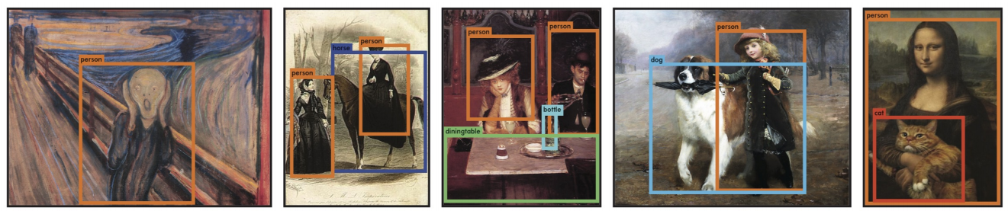
Key Points
Fast: YOLO - 45 fps, YOLO-tiny - 155 fps.
End-to-end training.
Makes more localization errors but is less likely to predict false positives on background
Performance is lower than the current state of the art.
Combined Fast R-CNN + YOLO model is one of the highest performing detection methods.
Learns very general representations of objects: it outperforms other detection methods, including DPM and R-CNN, when generalizing from natural images to other domains like artwork.

Slide 72
Links
Arxiv: https://arxiv.org/abs/1506.02640
Blog: http://pjreddie.com/publications/yolo/
Darknet: https://github.com/pjreddie/darknet
Caffe: https://github.com/xingwangsfu/caffe-yolo
Tensorflow:
Test+train: https://github.com/thtrieu/yolotf
Test: https://github.com/gliese581gg/YOLO_tensorflow

Slide 73
Thank you!
Our website: deepsystems.io
Our team is looking for business partners to make exciting deep learning solutions.

